Slide 1
Swing Components

Slide 2
JLabels

Slide 3
JLabels
The simplest UI component is not surprisingly one of the most popular. Labels are used all over the place to indicate functionality, display status, and draw focus.
The one thing labels cannot do is accept user input. We’ll learn about that later.
Let’s start out by creating a window and adding a label to it. The code is on the next slide.

Slide 4
class Labels
import javax.swing.*;
import java.awt.*;
public class Labels {
public static void main(String[] args){
JFrame frame = new JFrame( "Hello, Java!" );
frame.setSize( 300, 300 );
frame.setVisible( true );
}
}
This code creates a new window and sets its size and makes it visible. Yes, it will not be visible otherwise!

Slide 5
Add our Label
Create the JLabel object.
JLabel label = new JLabel("Hello, Java!");
Add the label to the window:
frame.add(label);
Make sure you put this code BEFORE frame.setVisible()

Slide 6
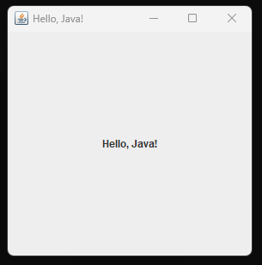
Now compile and run your project
More fun, eh? Let’s add some more features:

Slide 7
Set the Layout Manager for the Window
There are a number of layout managers available. FlowLayout is the simplest:
The FlowLayout class fills a container by horizontally centering components at the top, adding from left to right until that “row” runs out of room, then continuing on a new row below.
This type of arrangment won’t be of much use in larger applications, but it is ideal for getting items on the screen quickly.
frame.setLayout(new FlowLayout( ));

Slide 8
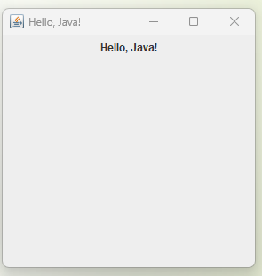
Now compile and run your project
Notice the location of the label. Add another feature:

Slide 9
Location of Window
That window is showing up at the top left of the screen. That is its default location. It’s actually, the (0,0) location for graphics in the Java drawing world.
But we would like our window to show up in the middle of our screen.
frame.setLocationRelativeTo(null);
null gives us the center of the screen.
Run your program. The window should be displayed at the center of your screen.

Slide 10
Set the Action on Close
You may have noticed that after the program has run and you X it out to close the window, you do not get the cursor back in the cmd window. You have to close cmd and re-open it.
Unlike a Frame, a JFrame has some notion of how to respond when the user attempts to close the window.
The default behavior is to simply hide the JFrame when the user closes the window.
To change the default behavior, you invoke the method setDefaultCloseOperation(int operation);
These are the choices for the operation:

Slide 11
Operations
DO_NOTHING_ON_CLOSE Don't do anything; require the program to handle the operation in the windowClosing method of a registered WindowListener object.
HIDE_ON_CLOSE (Default): Automatically hide the frame after invoking any registered WindowListener objects.
DISPOSE_ON_CLOSE : Automatically hide and dispose the frame after invoking registered WindowListener objects.
EXIT_ON_CLOSE (defined in JFrame): Exit the application using the System exit method. Use this only in applications.

Slide 12
Our Choice
We choose JFrame.EXIT_ON_CLOSE.
Otherwise, the window is hidden by default and keeps running even though you cannot see it…
frame.setDefaultCloseOperation(JFrame.EXIT_ON_CLOSE);
Now run your program and close the window. You will see the caret waiting for you to give it another command.

Slide 13
The Result
/***********************************************
* Ivonne Nelson inelson1@cnm.edu
* Labels.java
* This program prints a hello message.
************************************************/
import javax.swing.*;
import java.awt.*;
public class Labels {
public static void main(String[] args){
JFrame frame = new JFrame( "Hello, Java!" );
frame.setLayout(new FlowLayout( ));
frame.setDefaultCloseOperation(JFrame.EXIT_ON_CLOSE);
frame.setLocationRelativeTo(null);
JLabel label = new JLabel("Hello, Java!", JLabel.CENTER );
frame.add(label);
frame.setSize( 300, 300 );
frame.setVisible( true );
}}

Slide 14
Let’s do more!
Add three more labels to the frame. Create the label objects:
JLabel another = new JLabel("Another Label");
JLabel simple = new JLabel("A Simple Label");
JLabel standard = new JLabel("A Standard Label");
and add them to the frame.
frame.add(another);
frame.add(simple);
frame.add(standard);

Slide 15
Code for JLabel Demo
public class Labels {
public static void main( String[] args ) {
JFrame frame = new JFrame( "JLabel Examples" );
frame.setLayout(new GridLayout(0,1));
frame.setDefaultCloseOperation(JFrame.EXIT_ON_CLOSE);
frame.setSize( 300, 300 );
JLabel basic = new JLabel("Default Label");
JLabel another = new JLabel("Another Label");
JLabel simple = new JLabel("A Simple Label");
JLabel standard = new JLabel("A Standard Label");
frame.add(basic);
frame.add(another);
frame.add(simple);
frame.add(standard);
frame.setVisible( true );
}

Slide 16
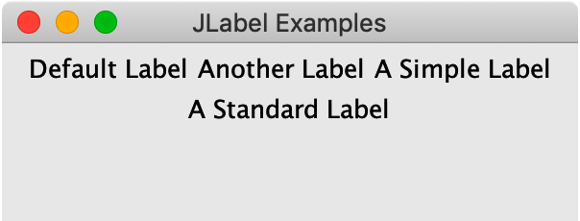
Run your program and see:

Slide 17
Set the Labels background colors
import java.awt.Color;
label.setOpaque(true);
label.setbackground (Color.YELLOW);
Do the same for the other three labels, using different colors. The Java Color Constants are on the next slide.
if the background color is dark, Change the text color - set: labelName.foreground(Color.WHITE);

Slide 18
BLACK black
BLUE blue
CYAN cyan
DARK_GRAY darkGray
GRAY gray
GREEN green
LIGHT_GRAY lightGray
MAGENTA magenta
ORANGE orange
PINK pink
RED red
WHITE white
YELLOW yellow
The color constants are the COLORS in caps.
The lowercase colors are not constant but they work, too.

Slide 19
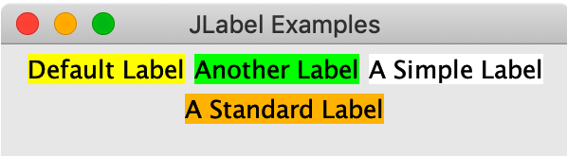
Now compile and run your project
Notice the location of the labels. This is how a FlowLayout works.

Slide 20
Change the style of the text, and its location in the label
Yes, we can change lots of things on our labels.
Background color
Foreground color
Font
Alignment
Add icons
Use the code on the next two slides in the appropriate places to do all of this. Be sure you download the image in the assignment and add it where the Application can access it.

Slide 21
JLabel centered = new JLabel("Centered Text", JLabel.CENTER);
centered.setPreferredSize(new Dimension(150, 24));
centered.setOpaque(true);
centered.setBackground(Color.WHITE);
JLabel times = new JLabel("Times Roman");
times.setOpaque(true);
times.setBackground(Color.WHITE);
times.setFont(new Font("TimesRoman", Font.BOLD, 18));
JLabel styled = new JLabel("<html>Some <b><i>styling</i></b>" +
" is also allowed</html>");
styled.setOpaque(true);
styled.setBackground(Color.WHITE);

Slide 22
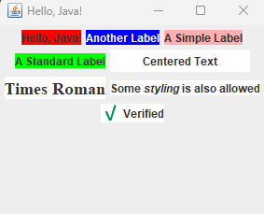
JLabel icon = new JLabel("Verified", new ImageIcon("ch10/check.png"),
JLabel.LEFT);
icon.setOpaque(true);
icon.setBackground(Color.WHITE);
…
frame.add(centered);
frame.add(times);
frame.add(styled);
frame.add(icon);
********************************************
Run your program and get something like this:

Slide 23
Buttons

Slide 24
Buttons
The other near-universal component you’ll need for graphical applications is the button.
The JButton class is your go-to button in Swing.
You’ll also find other popular button types such as JCheckbox and JToggleButton in the documentation.
Creating a button is very similar to creating a label:
First, create the Button object
Set its attributes
Add it to the Window.
You can control the colors, alignment, font, and so on for buttons in much the same way as you do for labels.

Slide 25
Buttons React to Being Pressed
The difference, of course, is that you can click on a button and react to that click in your program, whereas labels are static for the most part.
Try running this example and clicking on the button.
It should change color and feel “pressed” even though it does not perform any other function in our program yet.
Hopefully you’ve used enough applications or websites to be familiar with buttons and their behavior.
We want to go through a few more components before tackling that notion of “reacting” to a button click (an “event” in Swing-speak)!

Slide 26
JPanel
The JPanel class is the go-to container in Swing. It is a component just like JButton or JLabel, so your panels can contain other panels.
Such nesting often plays a big role in the layout of an application.
For example, you could create a JPanel to house the formatting buttons of a text editor in a “toolbar” so that it is easy to move that toolbar around according to user preferences.
JPanel gives you the ability to add and remove components from the screen. (More accurately, those add/remove methods are inherited from the Container class, but we access them through our JPanel objects.)

Slide 27
Text Components
Right behind buttons and labels in popularity would be text fields.
These input elements that allow for free-form entry of information are nearly ubiquitous in any forms.
You can grab names, email addresses, phone numbers, and credit card numbers.
You can do all that in languages that compose their characters, or others that read from right to left.

Slide 28
Text Components
Swing has three big text components that all extend a common parent, JTextComponent.
JTextField
JTextArea
JTextPane
JTextField is a classic text field meant for brief, single-word or single-line input.
JTextArea allows for much more input spread across multiple lines.
JTextPane is a specialized component meant for editing rich text.

Slide 29
JTextFields
Let’s get an example of each up in our simple, flowing application.
We’ll pare things back to a pair of labels and corresponding text fields, by far the more common of the two input components.
The code is on the next two slides:

Slide 30
Create a new Program, TextInputs
import javax.swing.*;
import java.awt.*;
public class TextInputs {
public static void main( String[] args ) {
JFrame frame = new JFrame( "JTextField Examples" );
frame.setLayout(new FlowLayout());
frame.setDefaultCloseOperation(JFrame.EXIT_ON_CLOSE);
frame.setSize( 400, 200 );
JLabel nameLabel = new JLabel("Name:");
JTextField nameField = new JTextField(10);
JLabel emailLabel = new JLabel("Email:");
JTextField emailField = new JTextField(24);
frame.add(nameLabel);
frame.add(nameField);
frame.add(emailLabel);
frame.add(emailField);
frame.setVisible( true );
}
}

Slide 31
Size of a Textfield
The size of a text field is dictated by the number of columns we specified in its constructor.
That’s not the only way to initialize a text field, but it is useful when there are no other layout mechanisms dictating the width of the field. (Here the FlowLayout failed us a bit—the “Email:” label did not stay on the same line as the email text field. But again, more on layouts soon.)
Go ahead and type something! You can enter and delete text; cut, copy, and paste as you’d expect; and highlight stuff inside the field with your mouse.

Slide 32
We can create an empty text area with a similar constructor as the one we used for JTextField, but this time specify the number of rows in addition to the number of columns. The code to add our text area to our running TextInput demo app is below, and the results are shown: JLabel bodyLabel = new JLabel("Body:"); JTextArea bodyArea = new JTextArea(10,30) //After the the other objects already added, add: frame.add(bodyLabel); frame.add(bodyArea);
Text Areas

Slide 33
Add a Text Area
Use your TextInputs Program. Add the code shown.
Also set the size to 400, 300. Run your code.
You can easily see we have room for multiple lines of text.
Try entering text. What happens if you type past the end of a line? You may get an odd text area that expanded to the size of our window and beyond
What happens when you press the Return key?
Hopefully, you get the behaviors you’re familiar with.

Slide 34
Set TextArea Properties
We’ll see how to adjust those behaviors below, but we do want to point out you still have access to its content just like you do with a text field.
TextArea has wrap properties that you can set:
bodyArea.setLineWrap(true); //makes it wrap
bodyArea.setWrapStyleWord(true); //doesn’t break words in the middle
Run your program and try it again!

Slide 35
JTextArea Properties
text
editable
columns
lineWrap
wrapStyleWord
rows
lineCount
tabSize

Slide 36
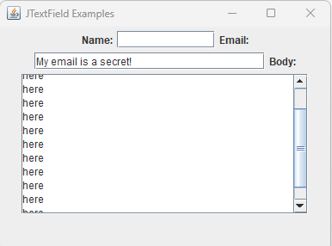
Text Scrolling
We’ve fixed what happens if we have too many characters for one line, but what happens if we have too many rows? On its own, JTextArea does that odd “grow until we can’t” trick.
Add a Scroll Bar:
frame.add(new
JScrollPane(bodyArea);
Run your program,add a lot of items,
And watch the scroll bar appear.

Slide 37
JSlider

Slide 38
What is a Slider?
Sliders are a nifty, efficient input component when you have a range of values.
You have probably seen sliders in things like font size selectors, color pickers (think the ranges of red, green, and blue), zoom selectors, etc.
The next slide shows how to create a slider in place.

Slide 39
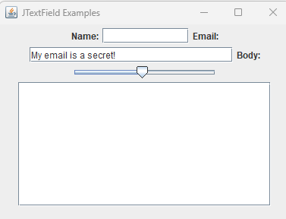
To Create a new Slider
To create a new slider, you typically provide three values: the minimum (0 for our angle slider), the maximum (180), and the initial value (we’ll go for the middle at 90).
Add a Slider to the TextInputs program, after the email textfield.
Create the Slider Object
JSlider slider = new JSlider(0, 180, 90);
Add the Slider to the frame
Run your program and there is the slider:

Slide 40
JList

Slide 41
Why use Jlist?
If you have a range of values but those values are not simple, contiguous integers, the “list” UI element is a great choice.
JList is the Swing implementation of this input type.
You can set it to allow single or multiple selections, and if you dig deeper into Swing’s features, you can produce custom views that display the items in your list with extra information or details.
For example, you can make lists of icons, or icons and text, or multiline text, etc., etc.

Slide 42
JList needs Information
Unlike the other components we’ve seen so far, JList requires a little more information to get started.
To make a useful list component, you need to use one of the constructors that takes the data you intend to show.
The simplest such constructor accepts an Object array.
While you can pass an array of strange objects, the default behavior of JList will be to show the output of your objects’ toString() method in the list.
Using an array of String objects is very common and produces the expected results.

Slide 43
Open a new file on Notepad++. Call it JListDemo
import javax.swing.*;
import java.awt.*;
public class JListDemo {
public static void main(String[] args) {
JFrame frame = new JFrame( "JTextField Examples" );
frame.setLayout(new FlowLayout());
frame.setDefaultCloseOperation(JFrame.EXIT_ON_CLOSE);
frame.setLocationRelativeTo(null);
frame.setSize( 400, 200 );
String[] cities = new String[] { "Atlanta", "Boston", "Chicago", "Denver" };
JList cityList = new JList<String>(cities);
frame.add(cityList);
frame.setVisible(true);
}
}

Slide 44
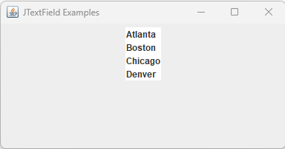
Run your project
See your JList:

Slide 45
JPanel
The JPanel class is the go-to container in Swing. It is a component just like JButton or JLabel, so your panels can contain other panels.
Such nesting often plays a big role in the layout of an application. For example, you could create a JPanel to house the formatting buttons of a text editor in a “toolbar” so that it is easy to move that toolbar around according to user preferences.
JPanel gives you the ability to add and remove components from the screen. (More accurately, those add/remove methods are inherited from the Container class, but we access them through our JPanel objects.)

